Slide 1
Climate Change and the Insurance Industry
A Study on American Wildfires
Manyi : Shaoyang : Francis : Sam

Slide 2
Overview
Prompt: How are businesses are affected by climate change?
Topic: Wildfire forecasting and ROI of mitigation techniques
Why we chose: This new natural disaster is growing in tandem with climate change
Insight: We discovered an entirely new sector that could benefit business and society alike.

Slide 3
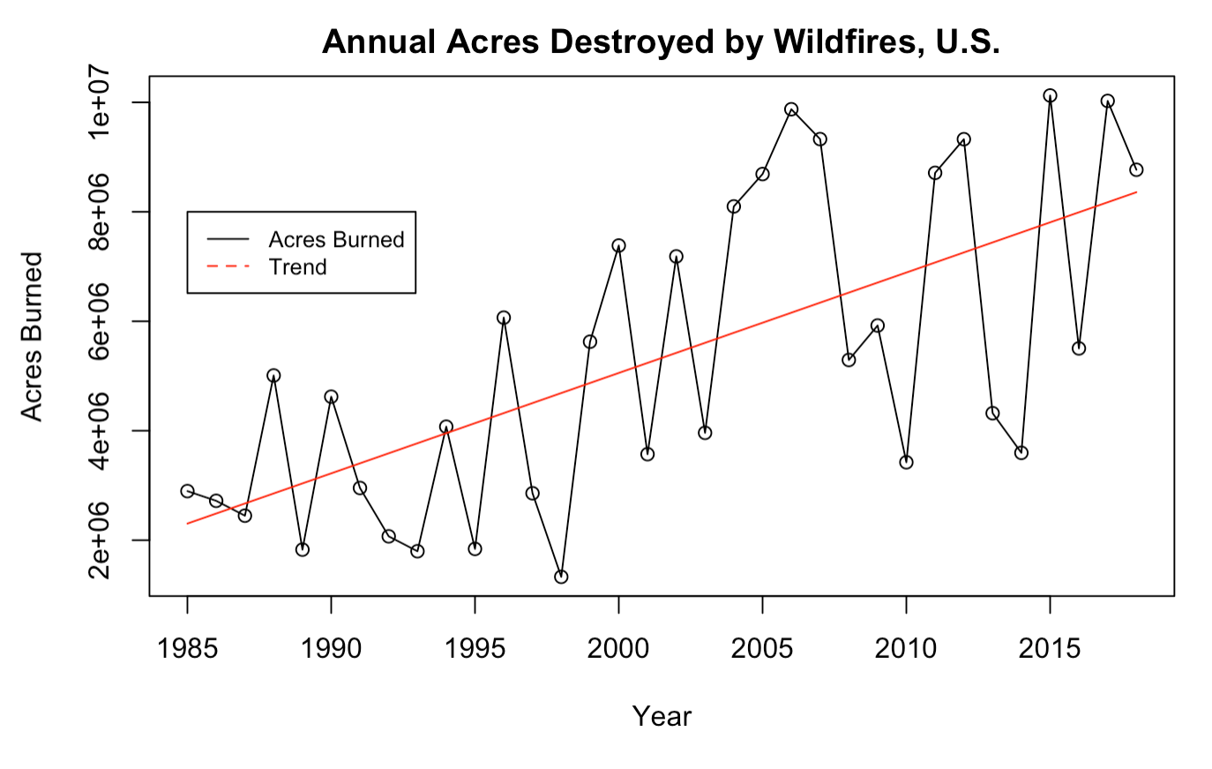
Background
Trend: Increase of 183,000 acres per year across the U.S.
We estimate a 21% increase in average fires within 10 years
Wildfires cost California $400 Billion
in 2018
Main Costs:
Business infrastructure
Destructions of homes
Firefighting costs
Our analytics are valuable to: Insurance companies, Homeowners, and At-risk businesses
Notes:
Wildfires and climate change are intertwined through a feedback loop
Wildfires release a lot of CO2 which fuel higher temperatures which in turn fuel more vicious fires
These natural disasters cause huge costs to residents and businesses
Wildfire growth is also causing uncertainty in insurance markets
2.1% INCREASE THIS YEAR

Slide 4
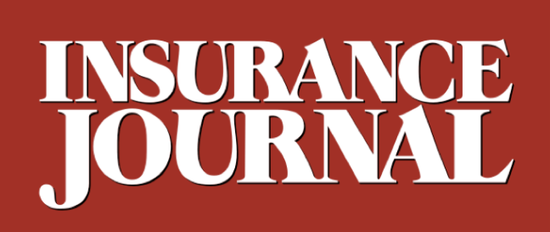
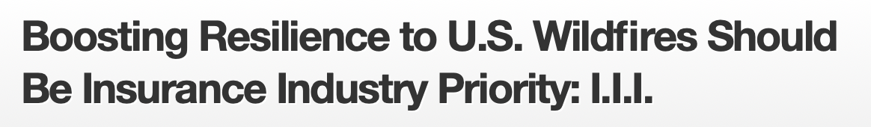
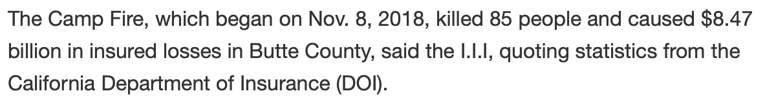

Slide 5
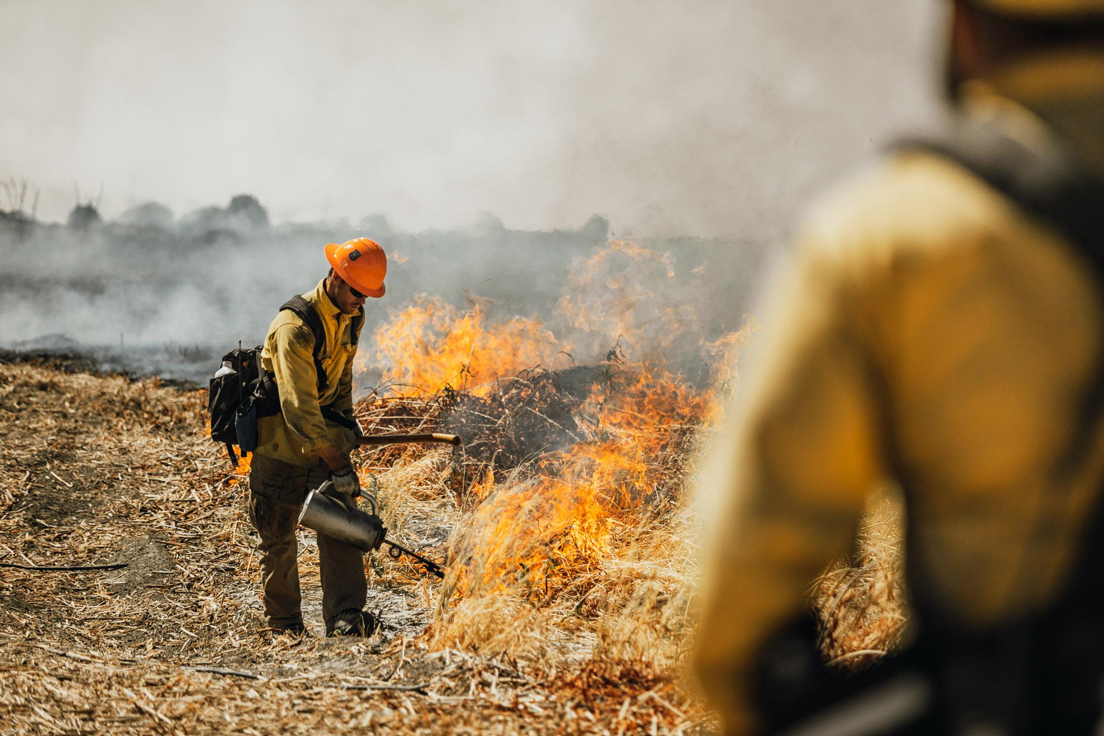
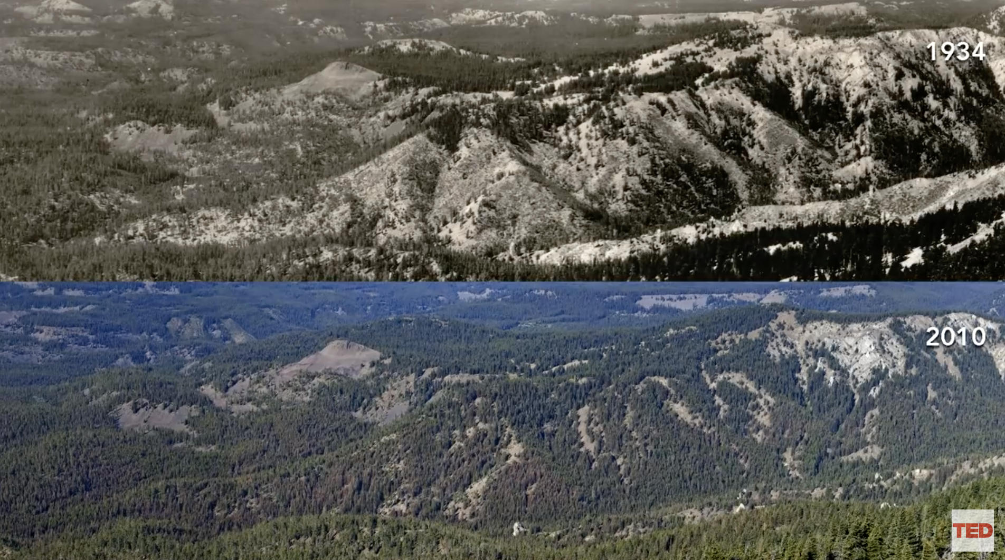
Prescribed Burns
Prescribed burns, also known as hazard reduction burning, backfire, swailing, or a burn-off, is a fire set intentionally for purposes of forest management, farming, prairie restoration or greenhouse gas abatement.
Prescribed fires help reduce the catastrophic damage of wildfire on our lands and surrounding communities by safely reducing excessive amounts of brush, shrubs and trees.
In 2018, California made plans to increase the amount of prescribed burning, “creating a culture where fire is a tool, not a threat”. Now, 125,000 acres of wildlands are intentionally burned each year in California.
Notes:
Francis
The average cost of prescribed natural fire (PNF) is $103.68 per acre burned. The variability in (PNF) ranking is high, ranging from least expensive in some Regions to the most costly in others. (USDA)
One of the critical variables in our wildfire analysis is called prescribed burn. So how does this prescribed burn work? Basically,

Slide 6
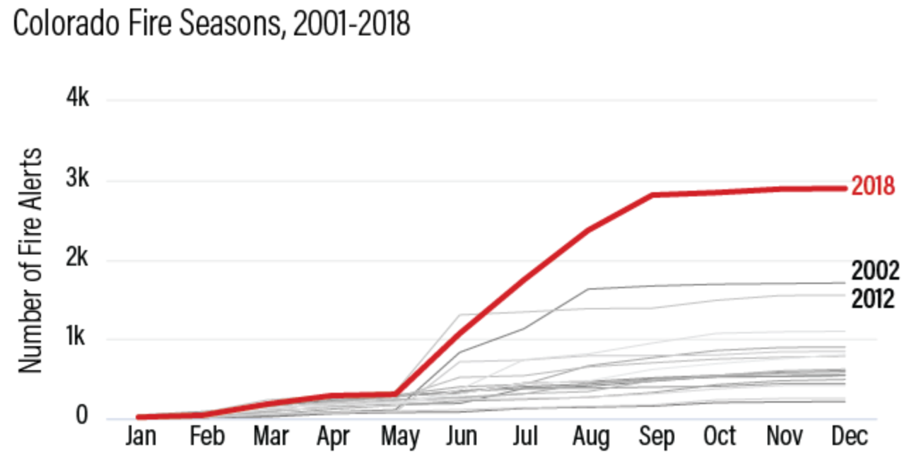
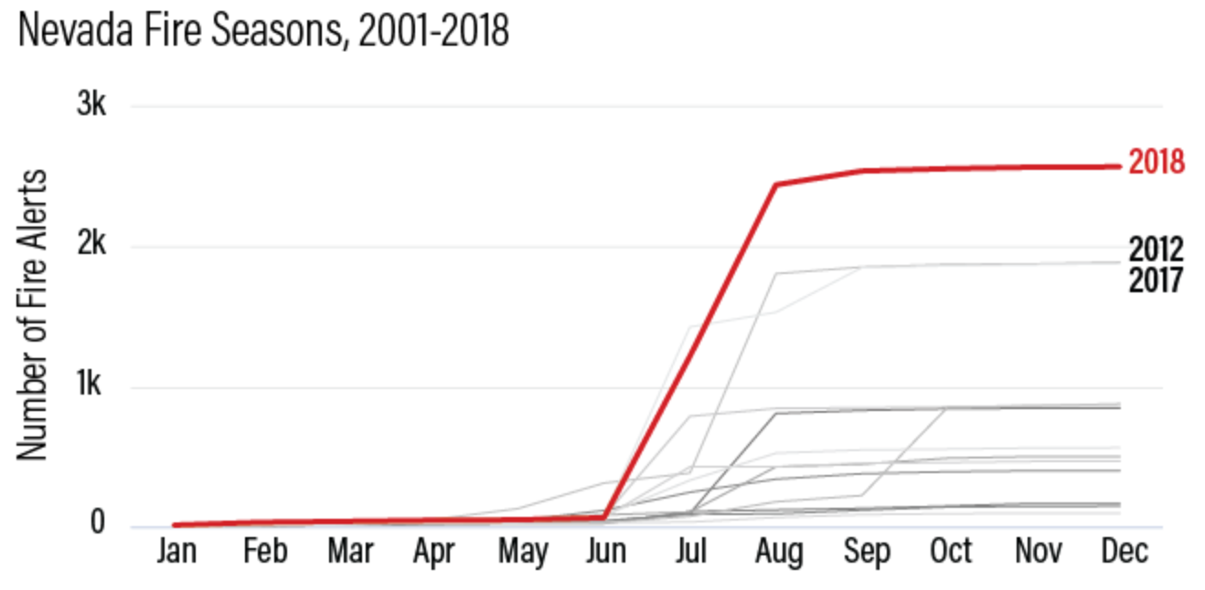
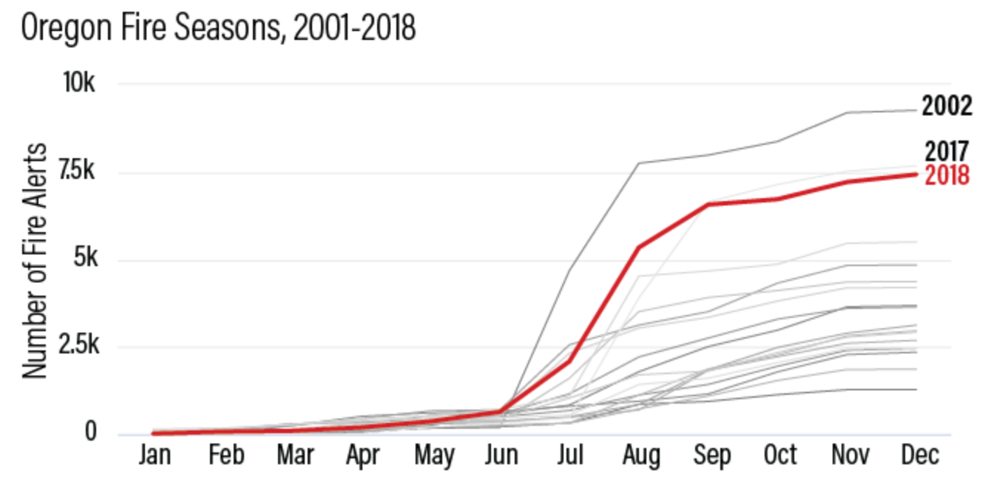
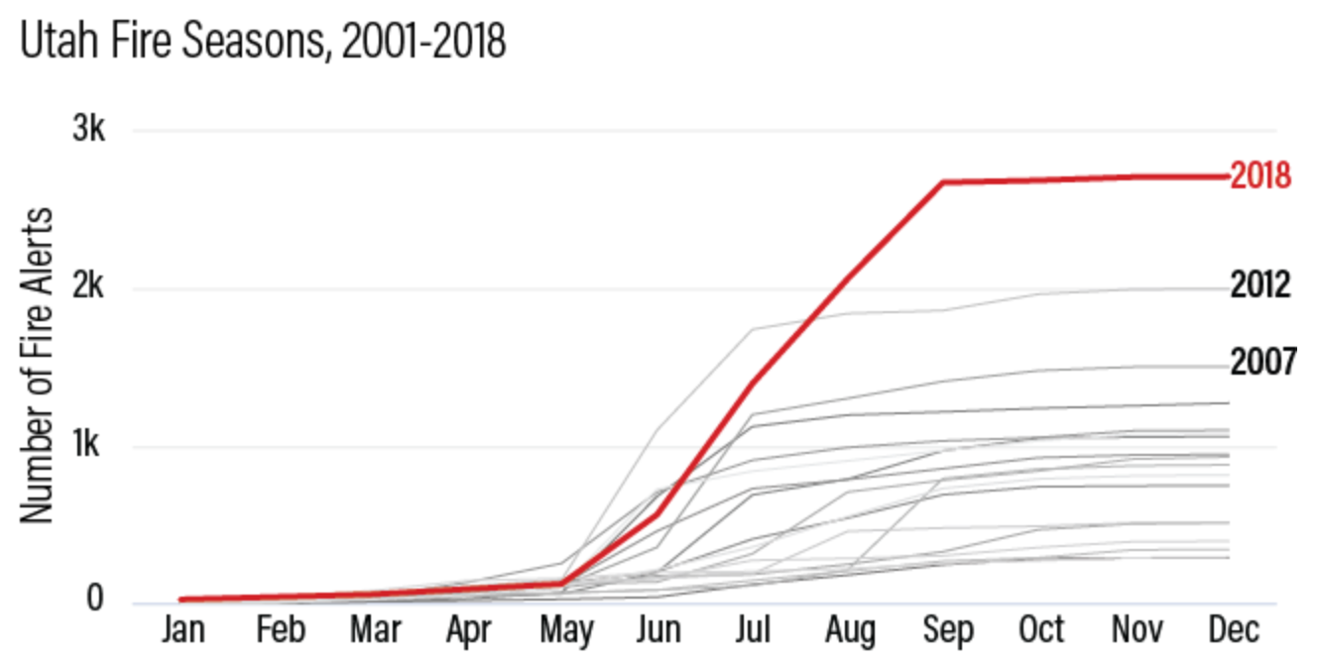

Fire Season By State
Colorado
Nevada
Oregon
Utah
Source: GFW Fires.
Notes:
Francis

Slide 7
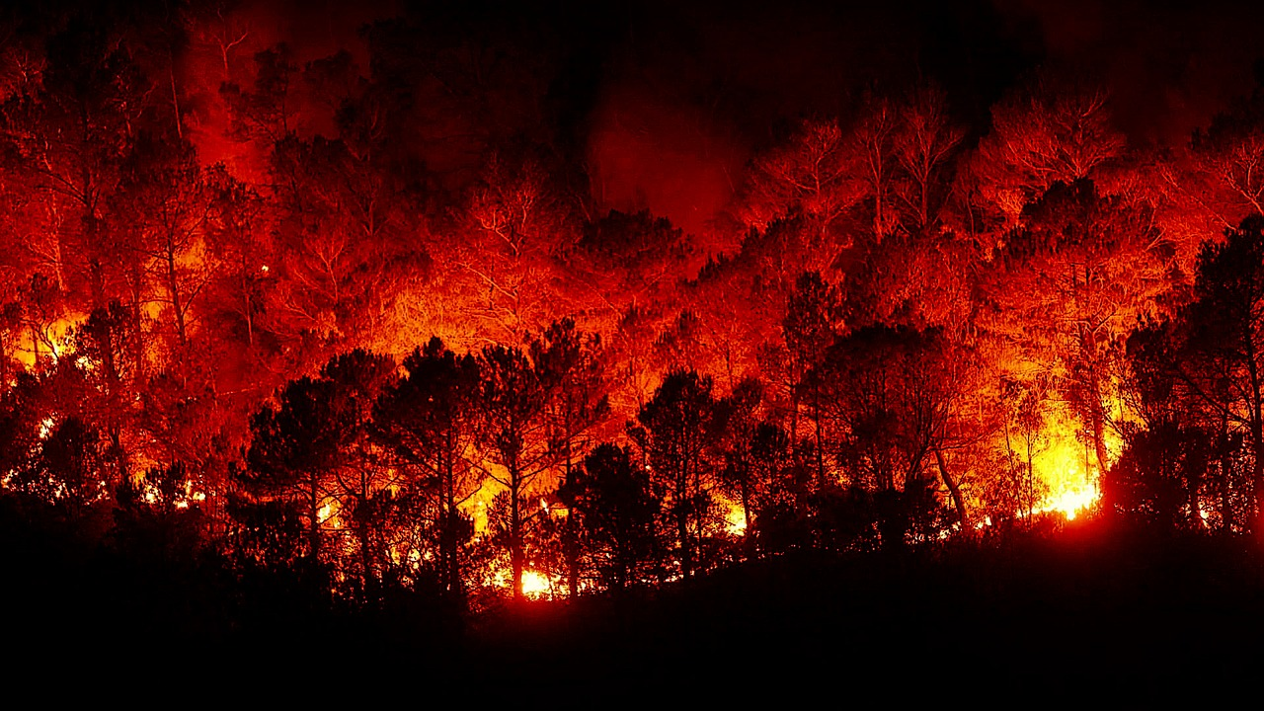
Variables
2017-2018
Rain
Weather data from the year pre-fire season making our model predictive.
Exhaustive subsets searching method.
Temperatures
Palmer Drought Index
Previous Years fires
Prescribed Burns
Notes:
Francis

Slide 8
Methods
Vector Autoregressive Model (VAR)
A time series forecasting tool that uses past data of many variables to predict future outcomes
Utah:
Granger Causality
An statistical test to check the direction of causality between two factors
Cross Validation
Re-Estimating the model with the systematic removal of data points to check for overfitting
Notes:
Guass-Markov theorem
5-assumptions
Can rain cause more fire? It depends.
Volatility in conditions, from rains to extreme drought, can prime the land for fire.

Slide 9
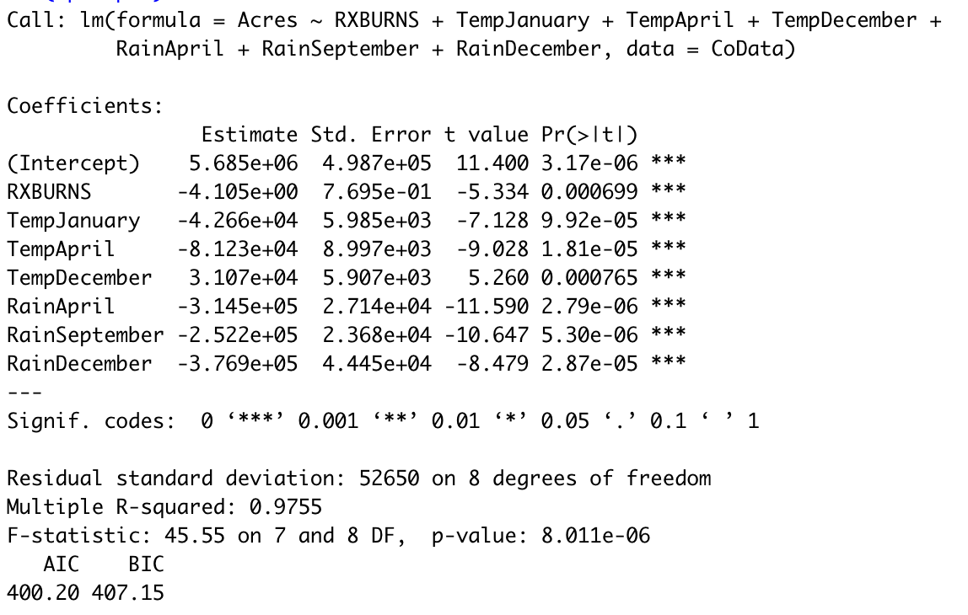
Results
Example Colorado:
Regression Table
From all-subsets regressions and granger test, find the main causality of wildfire in Colorado:
Prescribed burns significantly decrease the acres ruined.
Temperatures of winter and spring affect the wildfire next year.
Rain could strongly decrease the wildfire next year.
Prescribed burn
Temperature
Rain
Notes:
Ran granger causality test to show the prescribed burns influence the fires..
## grangerteat() is significant

Slide 10
Forecasts
CALIFORNIA
COLORADO
OREGAN
NEVADA
UTAH
States RX
COEFFICIENT:
-0.6
-4.1
-1.2
-2.4
-2.7
Source: Federal Fire Service
Interpretation of Coefficient
Reduction of Acres burned in Uncontrolled wildfires from a 1 Acre Prescribed burn
Cost to burn 1 Acre in a prescribed burn: $108.13

Slide 11
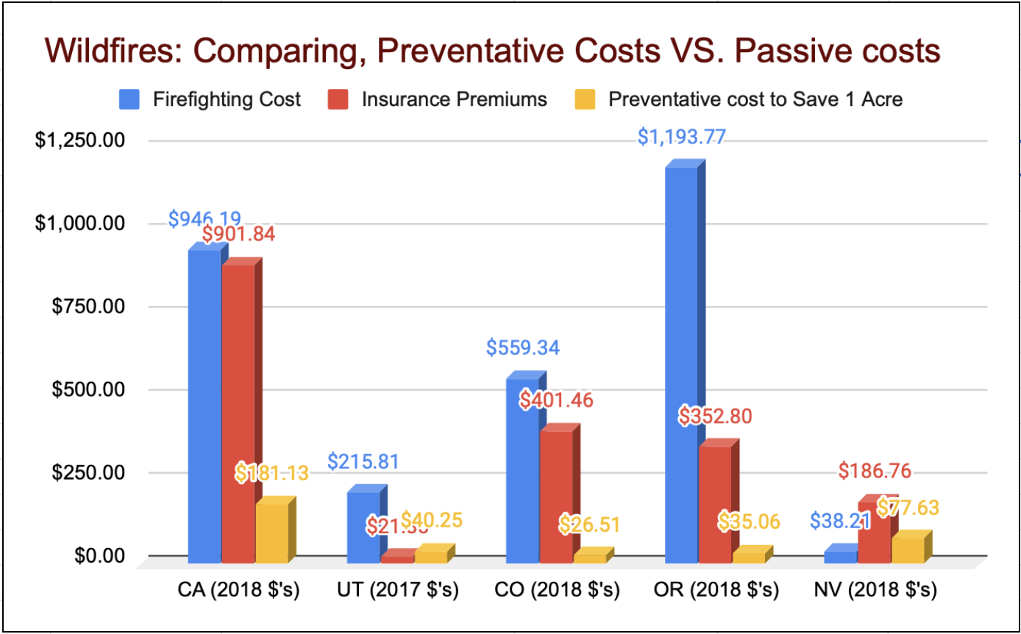

Slide 12
Future Works
1
Causal inference Machine Learning to prove RxBurns effects
2
More granular data provided by insurance companies
3
Collection data based on counties. Looking at individual fires within a zone
4
Reduce variable noise using Principal Component Analysis
Notes:
Causal inference Machine Learning to prove RxBurns effects-Shaoyang
More granular data provided by insurance companies-Manyi
Collection data based on counties. Looking at individual fires within a zone - Sam
More variables # PCA-Francis

Slide 13
Conclusion
Privatization of Prescribed burns is highly lucrative in insurance reduction
Possible subsidy has potential to be provided to this industry
There is more work to be done on the strategy of these techniques

Slide 14
Thank You for Listening

Slide 15
Sources
Insurance & Costs:
https://www.iii.org/fact-statistic/facts-statistics-wildfires
https://www.thebalance.com/wildfires-economic-impact-4160764
https://www.deseret.com/2018/8/18/20651507/utah-2018-wildfires-destroy-the-most-structures-in-past-15-years
https://www.usfa.fema.gov/data/statistics/#tab-4
Fire Data:
https://www.wri.org/blog/2019/03/california-made-headlines-5-other-us-states-also-broke-wildfire-records-2018
https://arstechnica.com/science/2020/01/why-isnt-california-using-more-prescribed-burns-to-reduce-fire-risk/
https://www.ncdc.noaa.gov/cag/statewide/time-series/4/pcp/all/1/2002-2007?base_prd=true&begbaseyear=1901&endbaseyear=2000
https://www.ncdc.noaa.gov/cag/national/time-series
https://www.fs.fed.us/psw/publications/documents/psw_gtr173/psw_gtr173_06_cleaves.pdf

